Slide 1


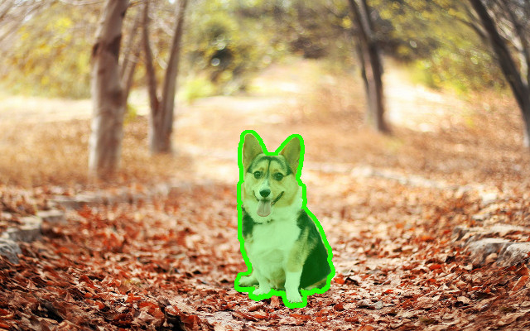
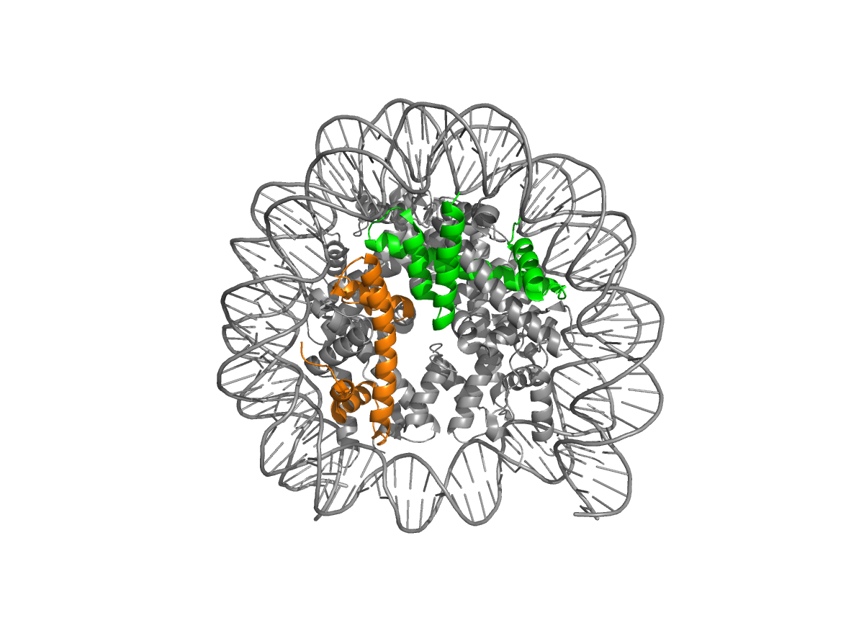
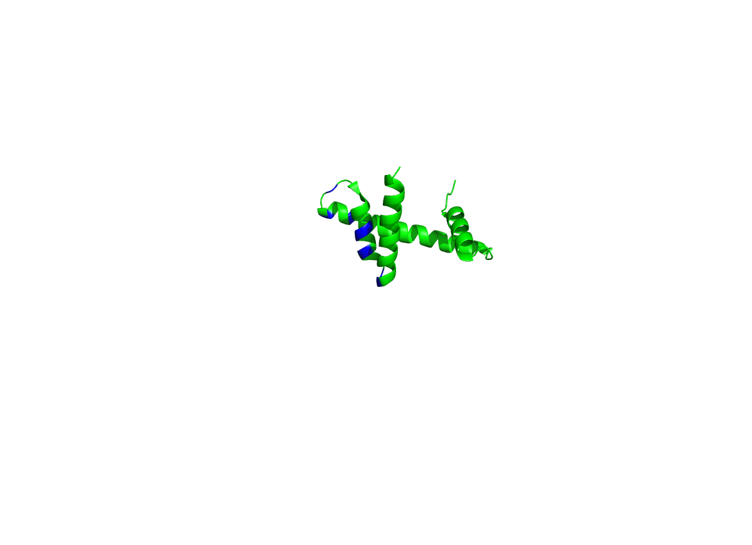
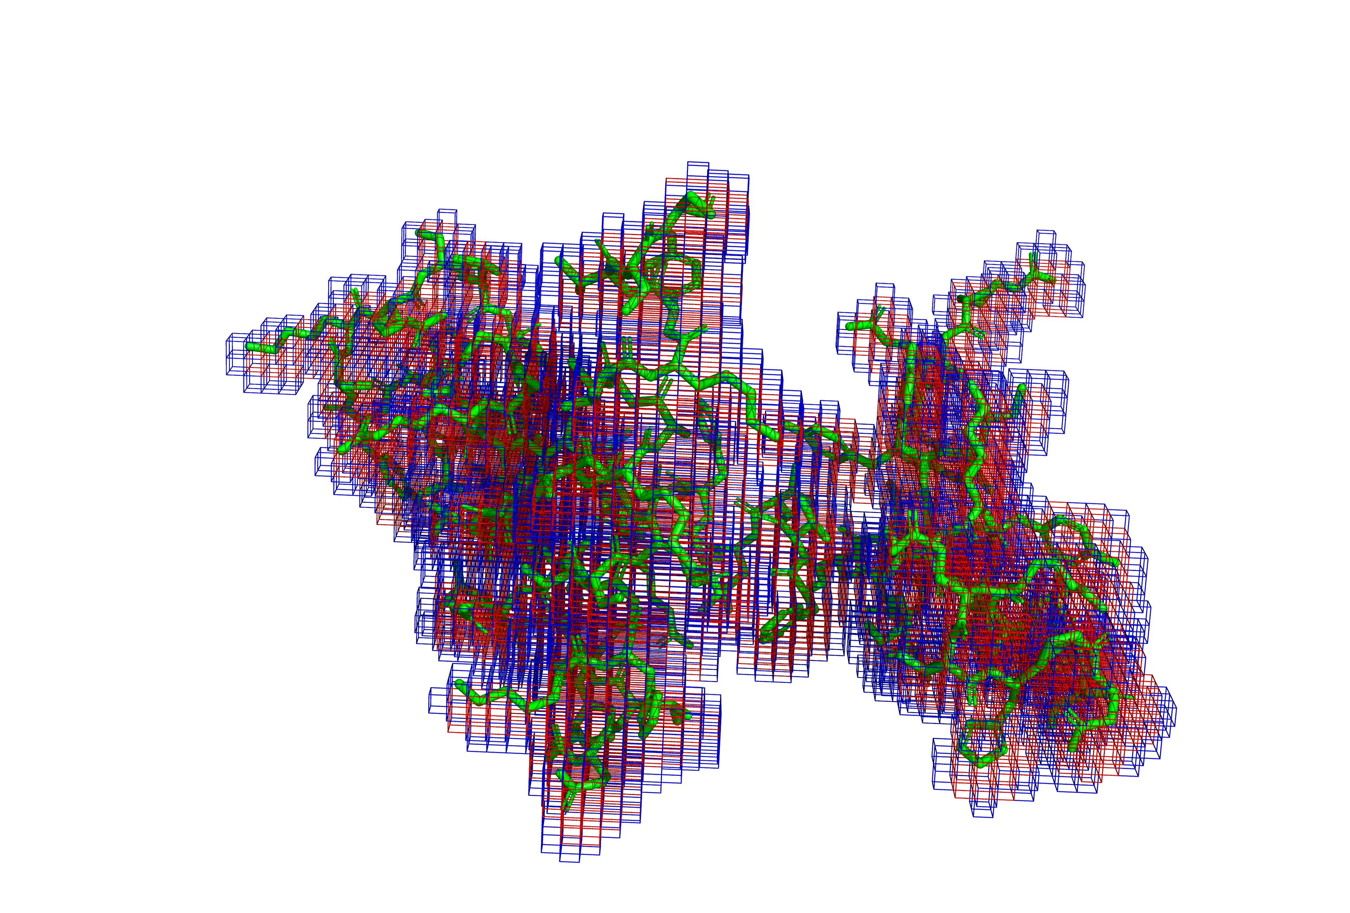
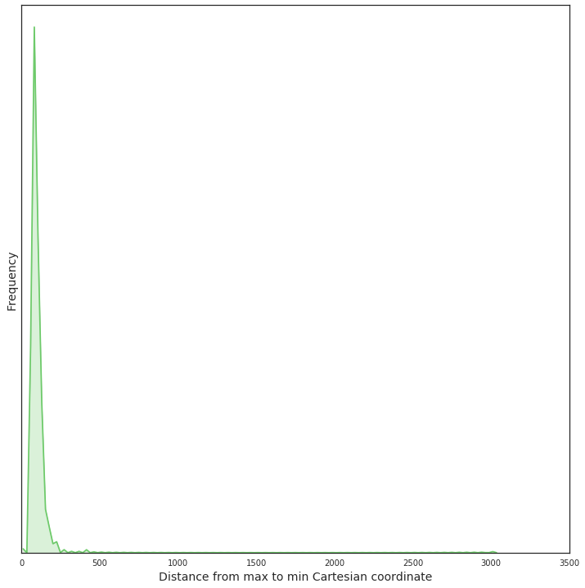
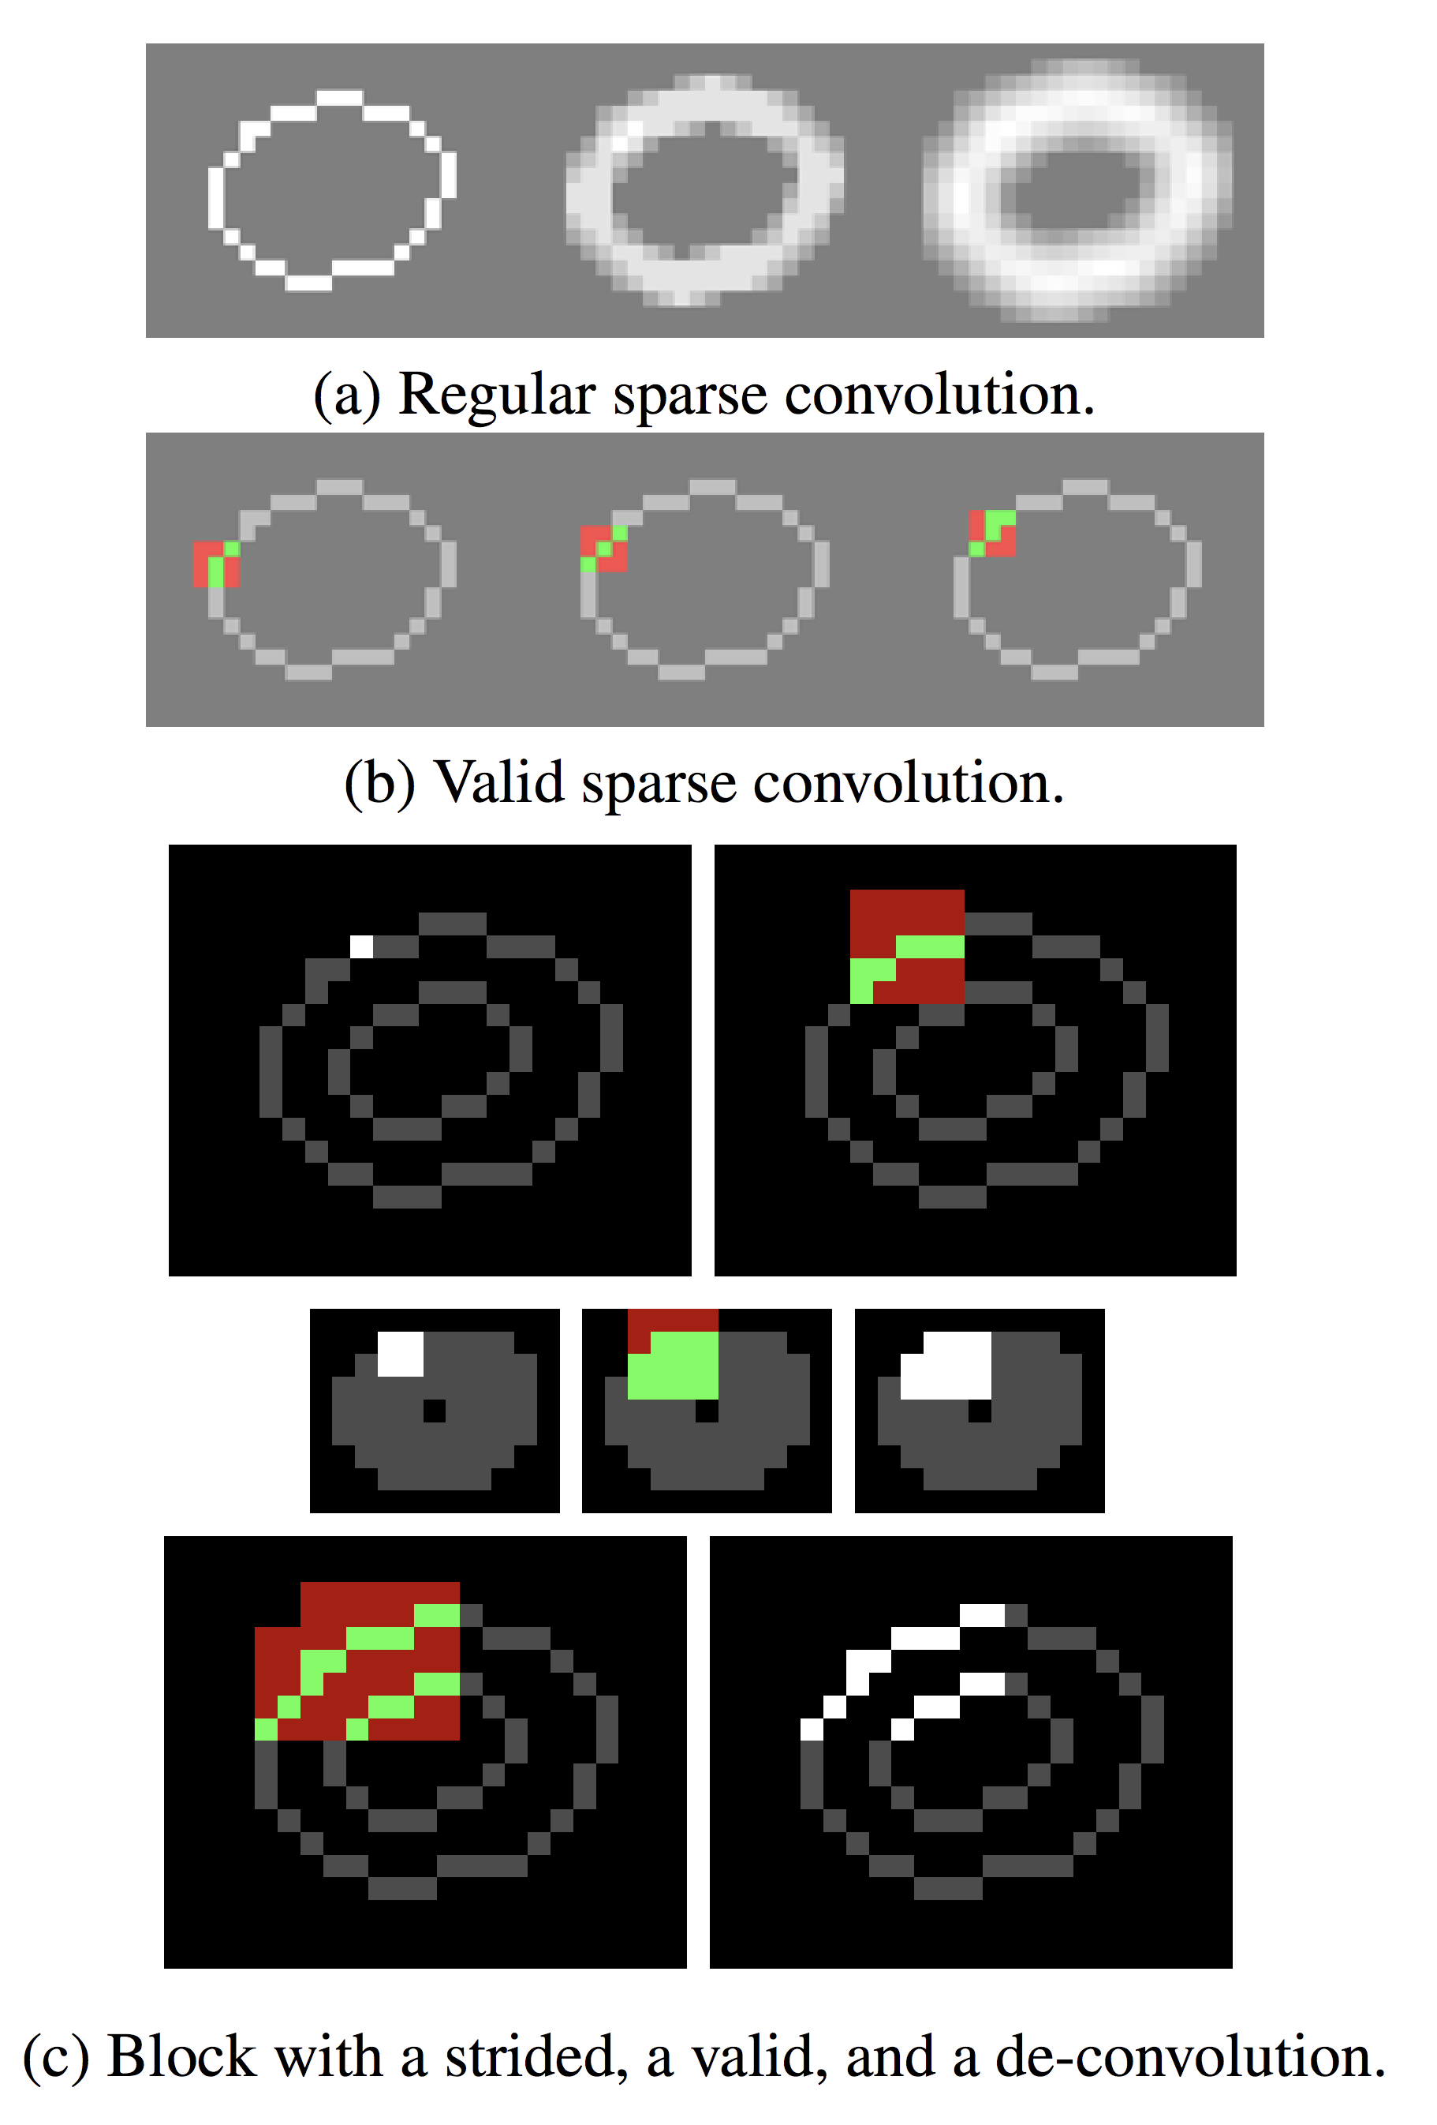


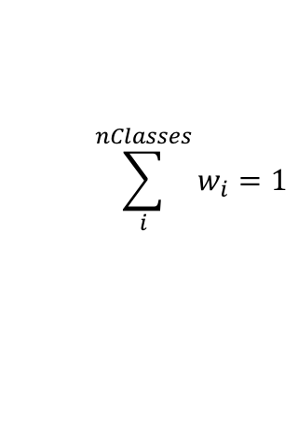
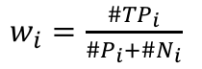
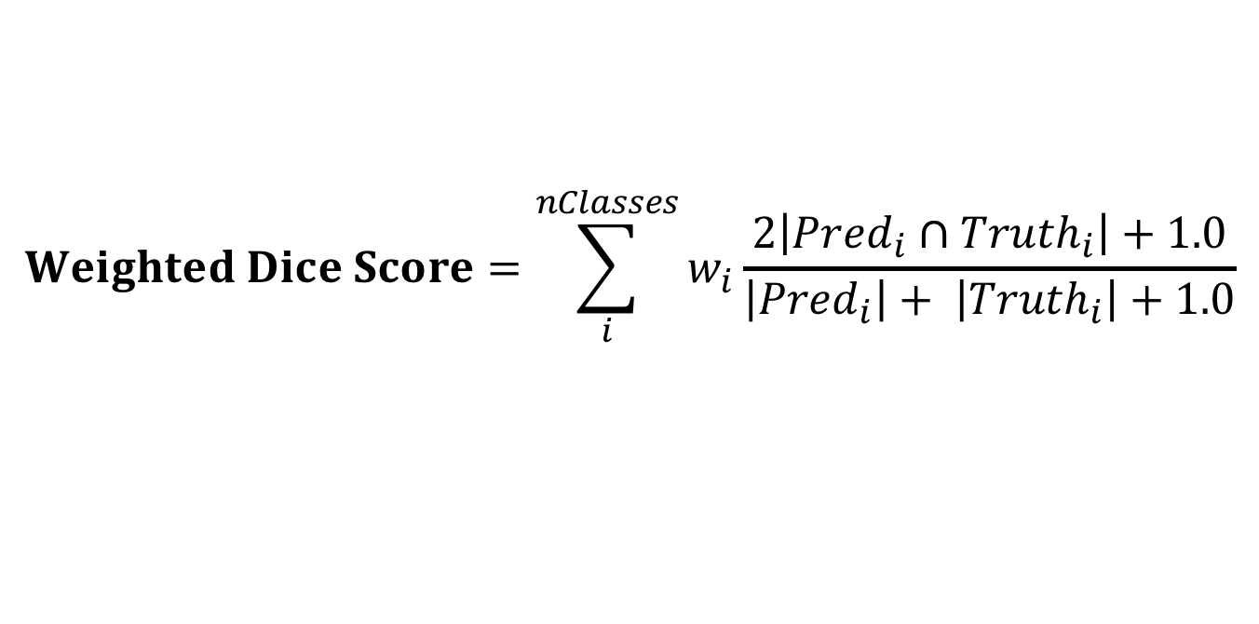
Identifying Structural Motifs involved in Protein-Protein Interactions using Deep Neural Networks
Eli J. Draizen^{1,2}, Alexandr Goncearenco¹, Anna R. Panchenko¹, Philip E. Bourne²
¹National Center for Biotechnology Information, National Library of Medicine, NIH, Bethesda, MD
²Department of Biomedical Engineering, University of Virginia, Charlottesville, VA
Background
Problem
Preliminary Results
Proteins-protein interactions (PPI) mediate many biological functions and are crucial to understanding biological pathways. Even though the cell is crowded, it is remarkable how two or more proteins can find each other to form transient and permanent interactions. Many methods exist to predict PPI from sequence and/or structure that exploit common features of binding sites such as hydrophobicity and evolutionary conservation, but either have too low accuracy or require significant homology to other proteins that are known to interact. Here, we present a Sparse 3D Fully Convolutional Neural network (3DCNN), or Sparse 3D U-net, to predict binding sites on proteins using structural information. Structures from the Inferred Biomolecular Interaction Server (IBIS) at the NCBI [4] were interrogated to obtain the correct size of voxels and grid. The Sparse 3D U-net was tested on an example dataset of hollow spheres. After 100 epochs, we get a cross entropy loss of 0.316 and weighted dice score of 0.932 when training on a NVDIA Tesla K80 GPU on Biowulf.
In a simplified model, protein surfaces and binding sites can be modelled as spherical shells and patches on the surface, respectively. Patches have the same features clustered together similar to a binding site. We chose to center the shells in a 96³ volume for memory constraints and speed and randomly select the shell radius from 15-30 to simulate different sized protein surfaces.
Voxels are assigned 3 random features: [1, 0, 0], [0, 1, 0], or [0, 0, 1], which could represent hydrophobicity or conservation, or red, green, or blue for easy visualization. 1-3 “binding sites” are chosen randomly from the voxels and expanded to include neighboring voxels within a random radius from 5-8. Voxels within the binding site are given the [0, 0, 1] or blue feature vector.
A common task in 2D computer vision is to identify which pixels in an image correspond to an object, i.e. dog. Our objective is to extrapolate this algorithm into 3D to predict regions on a protein structure, or voxels, that are involved in PPI. E.g. the binding site on H2B who interacts with H4 in the nucleosome.
Truth
Prediction
Dice: 0.958
Dice: 0.926
Dice: 0.937
Data and Preprocessing
Average Loss
(Cross Entropy)
Weighted Dice Coefficient
IBIS is a database of PPI binding sites derived from X-ray Crystallography or NMR or are homologous to proteins that do [4]. We only use sites representing the Last Universal Common Ancestor from a cluster of interfaces that have similar sequence and structure [3] to limit the amount of data.
H2B
H4
H2B:H4 Binding Site
Nucleosome Core Particle (3WKJ)
Model
A)
B)
Input
(n x 8)
Output
(n x 2)
Sparse Convolution (3³) +
Batch Norm and ReLu
Each epoch used 1000 random shells, split 80% training 20% validation, with 16 shells per batch. Since all shells are random, validation results are the same as training, only validation is shown.
256 Å
MaxPool (2³) or Convolution (2³, stride 2)
Conclusions and Future Work
256 Å
Deconvolution (2³)
256 Å
Convolution (1³) + Softmax Activation
3DCNNs have been used before on protein structures [5-7], but the use of a Sparse 3D U-net has not been tested before. The results on spheres seem promising and will hopefully be able to distinguish motifs in binding sites. I plan to expand this method by training on clustered interfaces to identify interaction partners, incorporate ligand binding sites for drug repurposing, and identify molecular mimicry of pathogenic proteins.
Skip Connection
0
500
1000
…
3000
3WKJ.F (red=bonding, blue=non-bonding)
Sparse 3D Volume
To find the optimum volume, we calculate the the maximum extent of all proteins in IBIS. We chose 256 Å because it is divisible 8, a requirement for 4 Max Pooling operations, and filters out large structures (Fig. A). Proteins are centered in a 256³ Å grid and each atom is mapped to 1 Å voxels using a KD-Tree (Fig. B). Only voxels that contain an atom are used, making this representation sparse.
A Sparse 3D U-net outputs voxel-level predictions for sparse 3D volumes. Sparse representations allow for larger batch sizes and feature vectors on a single GPU without running out of memory. The model is trained using Cross Entropy Loss and Stochastic Gradient Descent with Nesterov. A weighted Dice score is used ro evaluate the model. The Sparse 3D U-net is implemented in PyTorch using the SparseConvNet package [1, 2].
Features (8-vector)
Hydrophobic
Aromatic
H-bond acceptor
H-bond donor
Positive charge
Negative Charge
Metal
Voxels that contains an atom receive the atom features. If two atoms share the same voxel, i.e. for bonding (red in Fig. B), the maximum between the feature vectors is used. Features are stored in an 8-vector and are adapted from DeepSite [5].
References
Graham, Engelcke, Maaten. arXiv:1711.10275
Cicek, Abdulkadir, at al. International Conference on Medical Image Computing and Computer Assisted Intervention, 2016.
Goncearenco, Shaytan, et al. Biophysical J. 2015.
Shoemaker, Zhang, et al. Nucleic Acids Res. 2012.
Jiménez, Doerr, et al. Bioinformatics. 2017. doi: 10.1093/bioinformatics/btx350
Torng, Altman. BMC Bioinformatics. 2017. doi:10.1186/s12859-017-1702-0.
Amidi, et al. arXiv:1707.06017
Image of segmented dog by Olivier Grisel and Charles Ollion, available under the CC-By 4.0 license. https://m2dsupsdlclass.github.io/
$$Weighted Dice Score=\sum_{i}^{nClasses}{w_{i}\frac{2\left|{Pred}_{i}∩{Truth}_{i}\right|+1.0}{\left|{Pred}_{i}\right|+ \left|{Truth}_{i}\right|+1.0}}$$
After filtering, we have 3330 PDBs with 4080 binding sites, split 80% training and 20% validation.
$w_{i}=\frac{\#{TP}_{i}}{\#P_{i}+\#N_{i}}$
$$\sum_{i}^{nClasses}{w_{i}=1}$$
We would like to acknowledge Benjamin Graham (Facebook Research), David Landsman, Azhar Khandekar, Anna-Leigh Brown, Nicolas Fiorini (NCBI), Zheng Zhao, Cam Mura, Peter Kasson, and Mohammad Al Boni (UVA) for help and useful discussions about this project.
Convolution operations follow the active sites instead of the entire volume. (a) left: original curve; middle and right: 3² conv operations with weights 1/9. (b) Active sites are highlighted. From [1].
EliDraizen
edraizen

